Slide 1
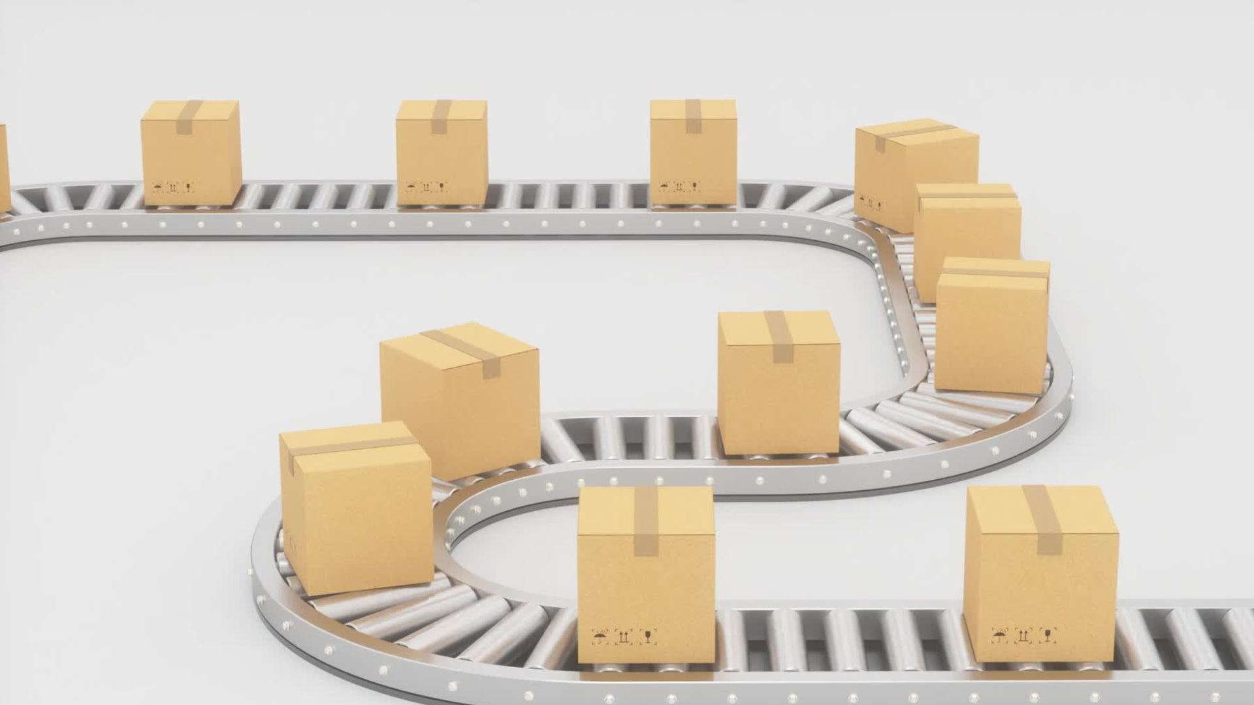
Sprint delivery
Miroslav Denkov

Slide 2

What am I even doing here?

Slide 3

So far...
Project Plan
Research
Company visit
Planning

Slide 4

Things to focus on for next sprint
Experiments with simulation software
Research and development on trajectory planning for the robot arm.

Slide 5

Thank you for your attention

